Slide 1

Sinclair Community College
August 23, 2021
1
Spring Affair Campaign Results
Marketing Overview
2
Analysis + Key Takeaways
3
New Campaign Proposal
4
Strategy
Presenter: Hannah R Bergman

Slide 2
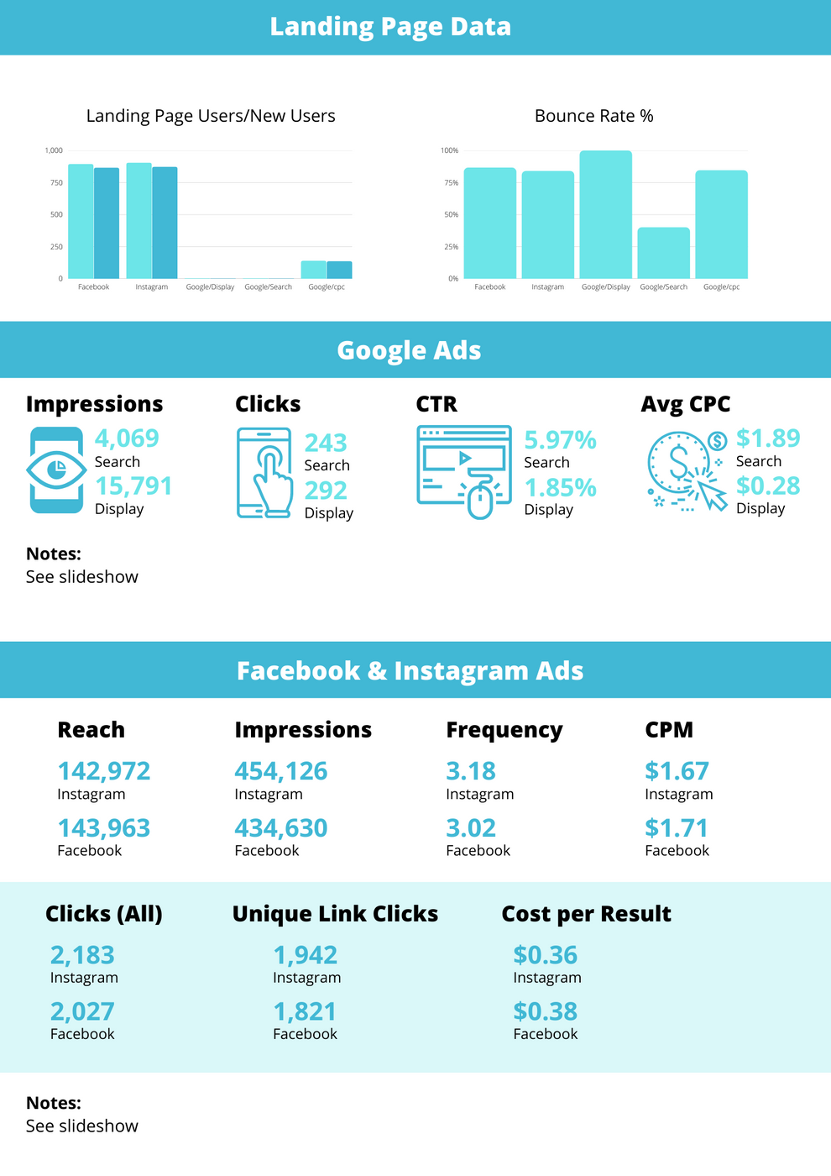
- Simplified design (customizable, can add/remove metrics according to what is wanted/needed)
- Using Google Data Studio and a 3rd party tool, such as Supermetrics, we can pull in results quickly using a pre-built template that pulls real-time data and adds comparisons of results from previous campaigns across all platforms (including Google Ads, Facebook, and Instagram)
Link to full document

Slide 3
Landing Page Analysis

Slide 4
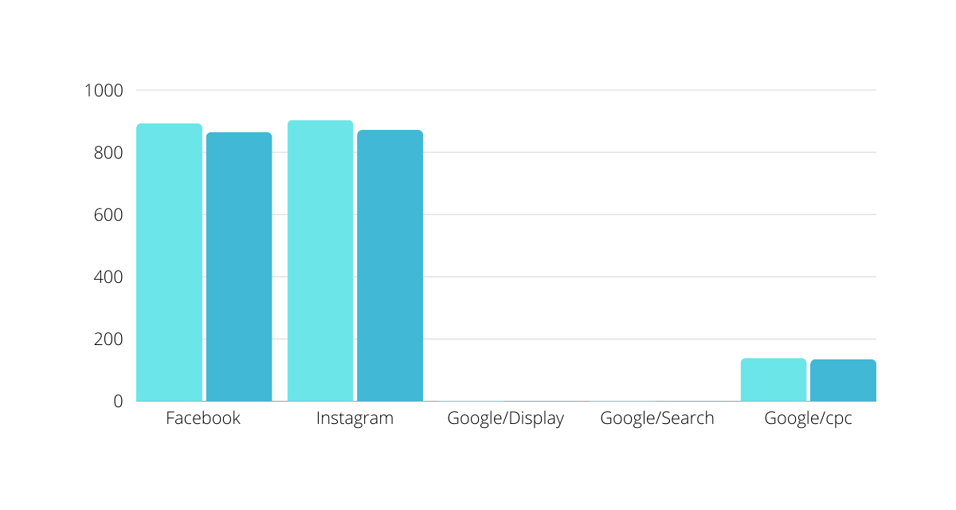
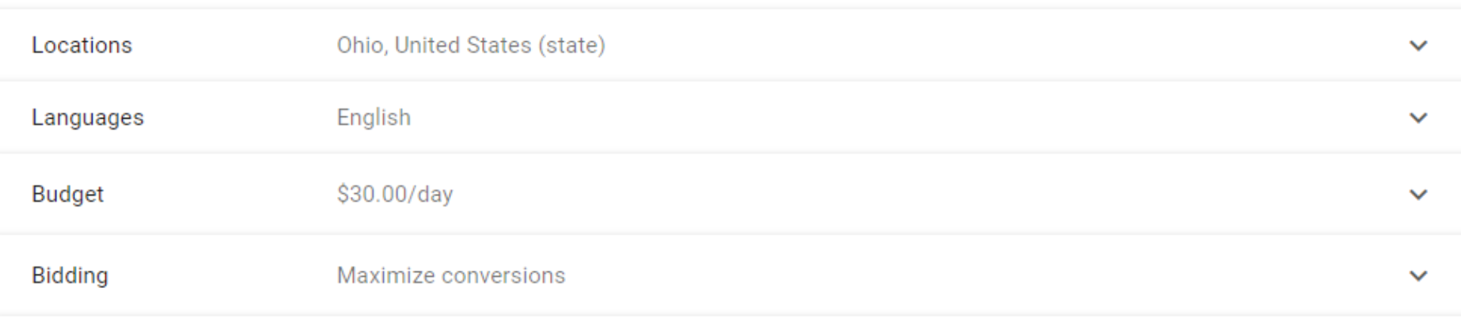
from Google Search Raw Data:
Looking at the landing page data, you can see that a majority of users came directly from FB/IG ads.
This could be a great indication that budget should be allocated to paid social since there seems to be a lot of potential success there.
There should be some concern with Google Ads. It appears there were only a very few number of people that were directed to the landing page from those ads, indicating the budget was likely too low. I'm assuming this may be the case, given the location radius (the entirety of Ohio, large amount of ad competition).
I'm also curious why "cpc" was separated?

Slide 5
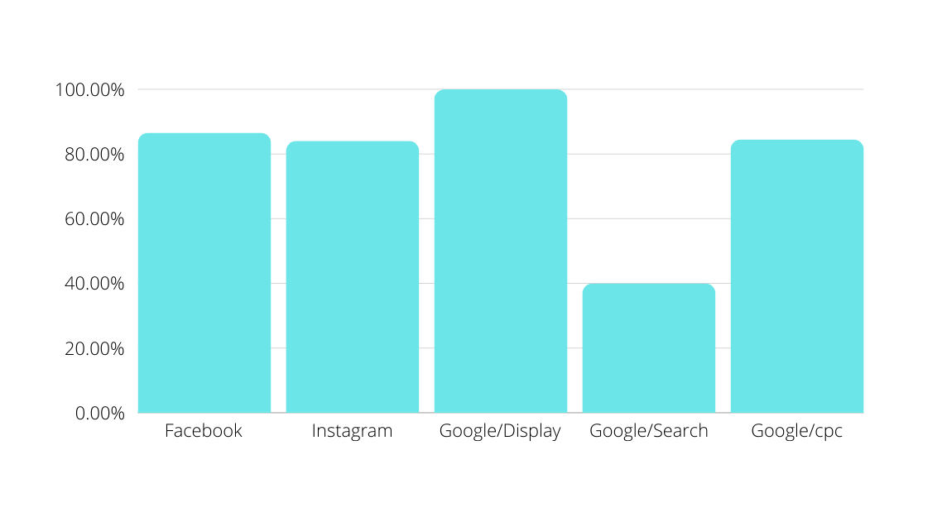
Another thing to note is the high bounce rate. Ideally, bounce rate should be within the avg range of 41-55%.
The high bounce rates indicate something likely needs to be adjusted on the landing page...

Slide 6
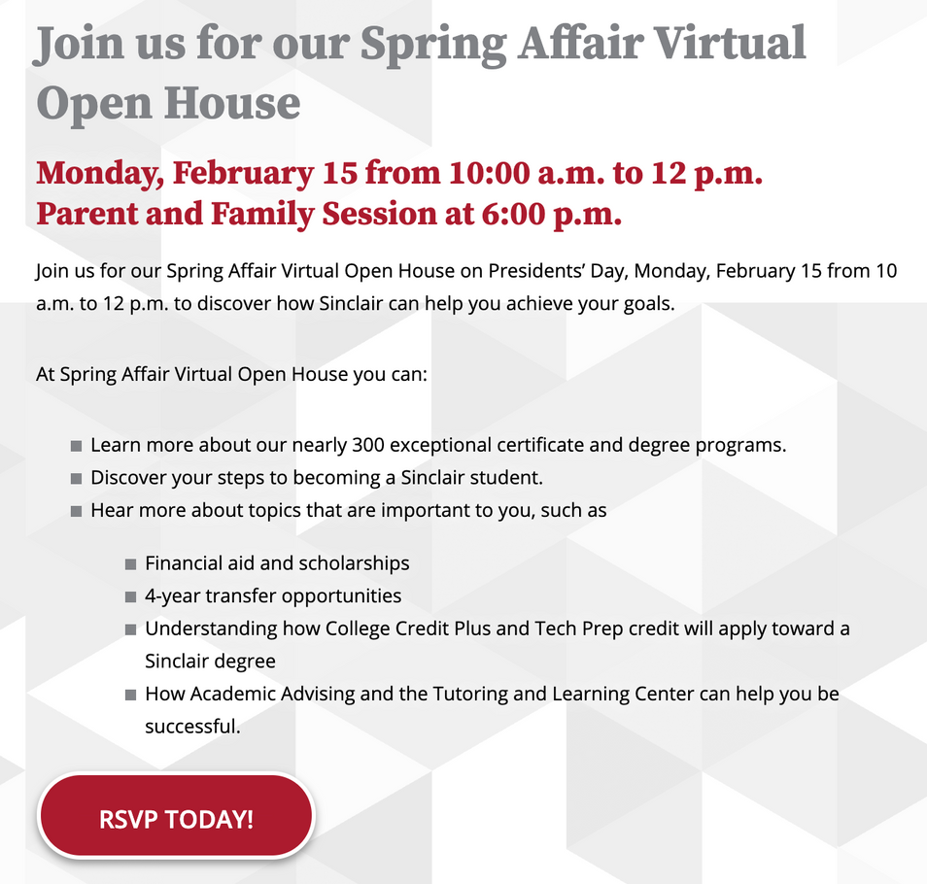

Looking at the landing page, I saw the CTA button leads to a form on another page - this is likely why the bounce rate is so high, people are clicking on that "RSVP Today!" button over to the form.
I'd recommend either adding the form directly to the landing page or making adjustments to only track the user going to that secondary page.

Slide 7
Google Ads Analysis

Slide 8
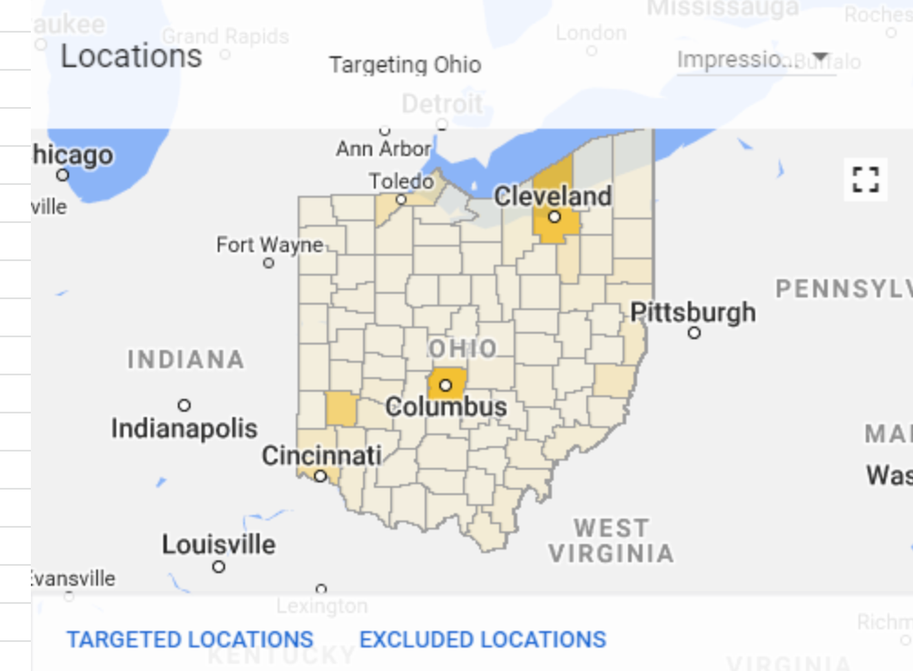
Budget Adjustment
from Google Search Raw Data:
As I mentioned in an earlier slide, there's a lot of competition if we're targeting the entirety of Ohio, especially considering there are approx. 25 other community colleges in Ohio competing with Sinclair.
Suggestions:
  Use the data we've collected to further refine our audience (See map)
  Increase our daily budget
  Based on the results seen from this campaign - reallocate the budget to paid social or...

Slide 9
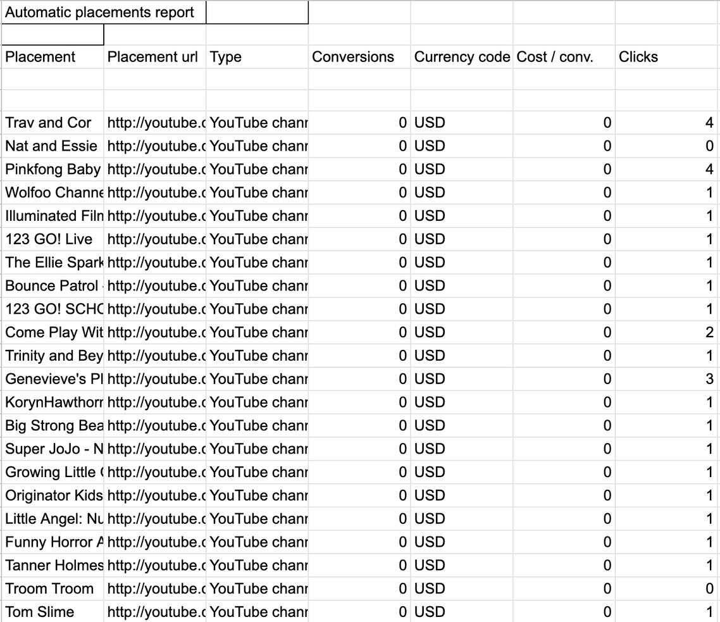
Google Smart Display
I noticed a lot of clicks coming from YouTube via the automatic placements report from the Google Smart Display campaign.
This may be a good indicator that it might be beneficial to run video ads on YouTube.
Having ran similar types of ads for service based industries, these tend to do really well for the demographic Sinclair is likely trying to reach, such as millennials who consume a majority of their digital content via YT and other streaming platforms.

Slide 10
FB & IG Ads Analysis

Slide 11
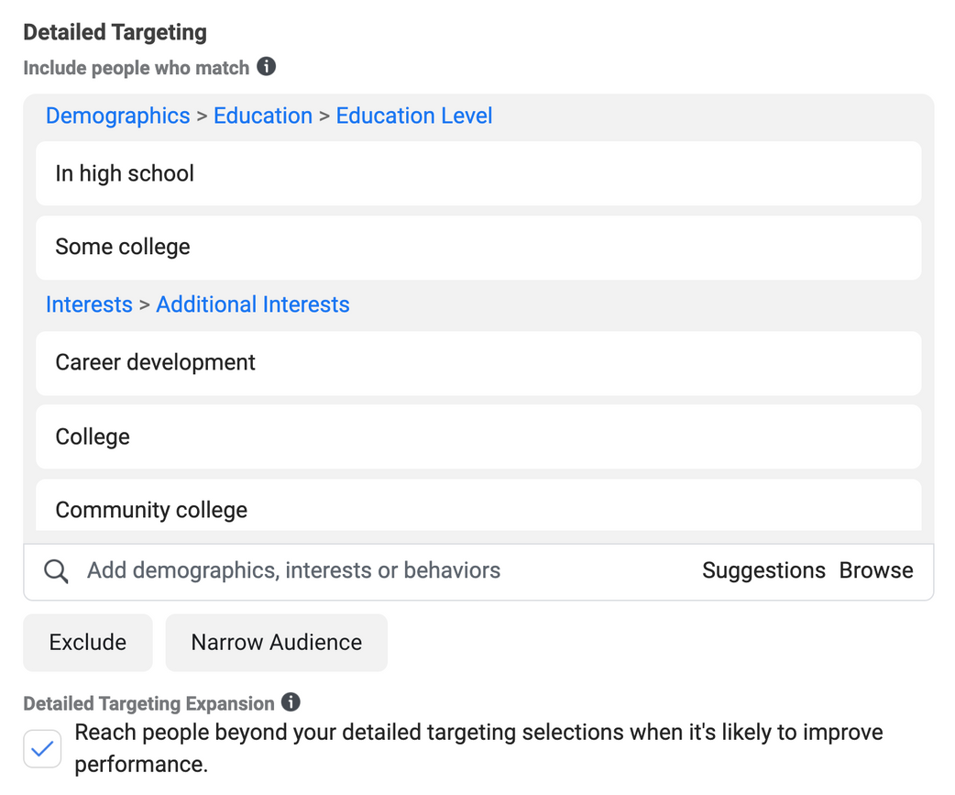
Detailed Targeting
Include Detailed Targeting to refine audience based on things like:
- Students still "In high school" (adjust age settings to align with those most likely to be graduating soon, 17-18+)
- People who may have attended college and then dropped out ("Some college")
- People interested in further "Career development" (can refine this option further based on specific program interests)
- People specifically interested in community college > college

Slide 12
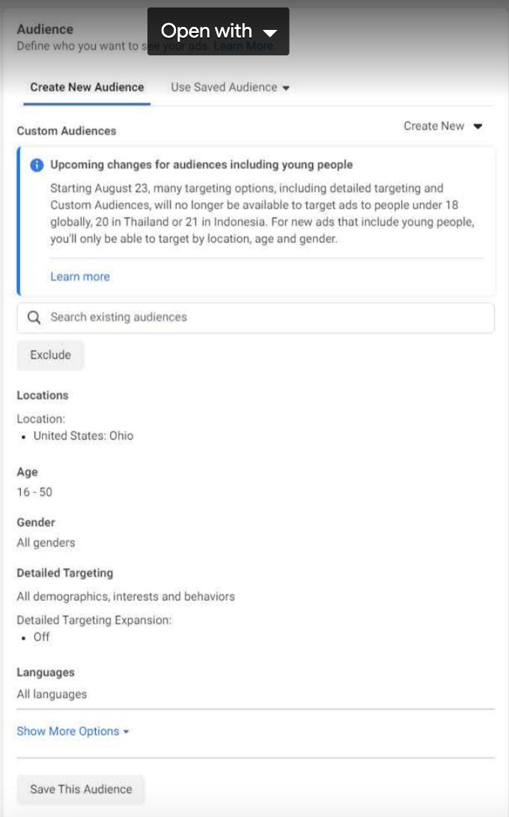
Detailed Targeting Expansion
"Detailed Targeting Expansion" should be "On" not off
This helps improve campaign performance by allowing FB's algorithm to reach a broader set of people than just those you've defined in this section.
Note: This can still be selected if no Detailed Targeting is defined!
Source: https://www.facebook.com/business/help/128066880933676?id=176276233019487

Slide 13
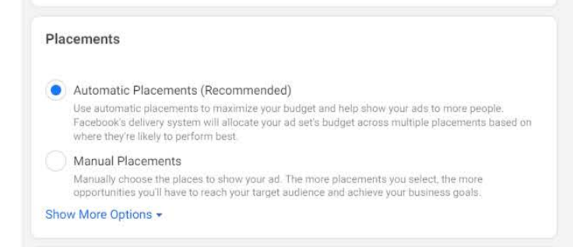
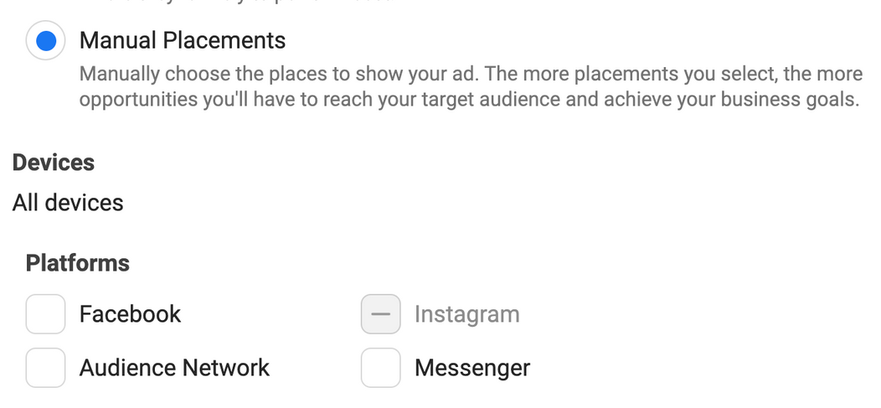
From pg 2 of https://drive.google.com/file/d/1SIraYaq3ufEIkJ2kEr2U5Mh5fua1FtIo/view:
IG
Spring Affair Ad Set
Click "Manual Placements" deselect FB options, select IG options, like this:
Since this is an IG focused campaign, Placements settings should be adjusted to "Manual Placements" and only the IG options should be selected'
Same should be applied to the FB only ad sets

Slide 14
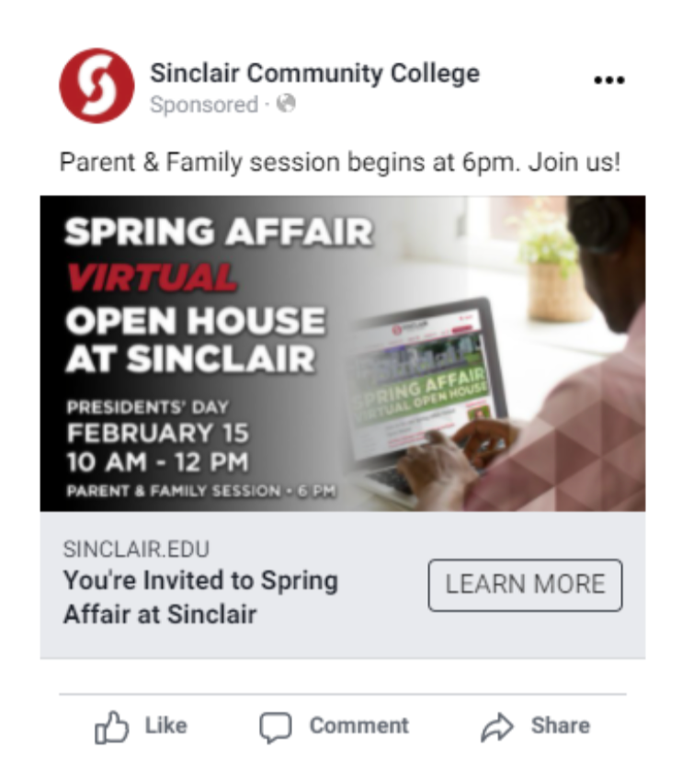
Decrease the amount of text in FB ads
While FB did remove the 20% rule (they would flatout disapprove ads that contained more than 20% text) in 2020, they still openly penalize ads for having too much text.
“Too much copy is distracting and can lead to your ad being shown to fewer people. Images that are uncluttered by text have greater impact, so stick to the most important details.”
Source: https://www.facebook.com/business/ads/photo-ad-format?ref=ads_guide

Slide 15
New Campaign Proposal & Strategy

Slide 16
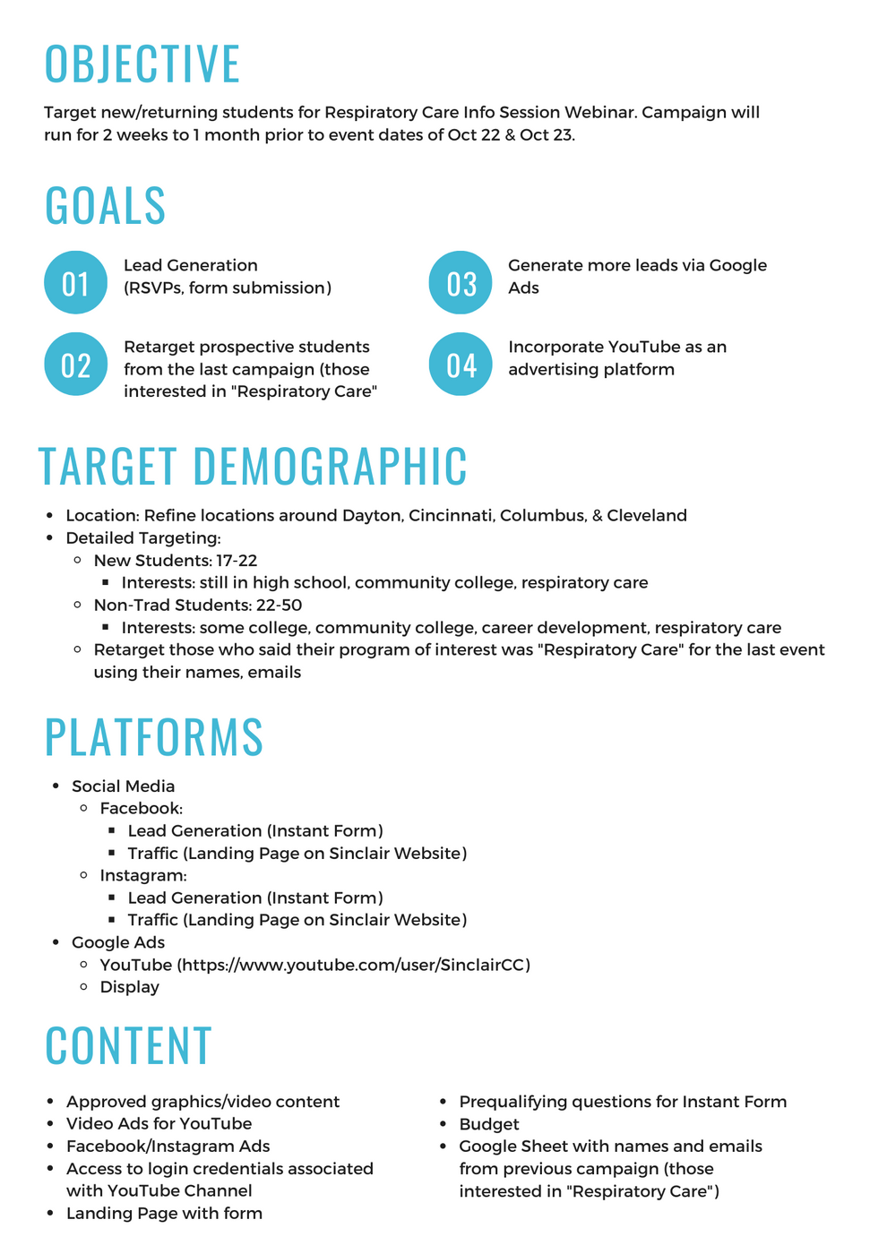
Link to full document

Slide 17
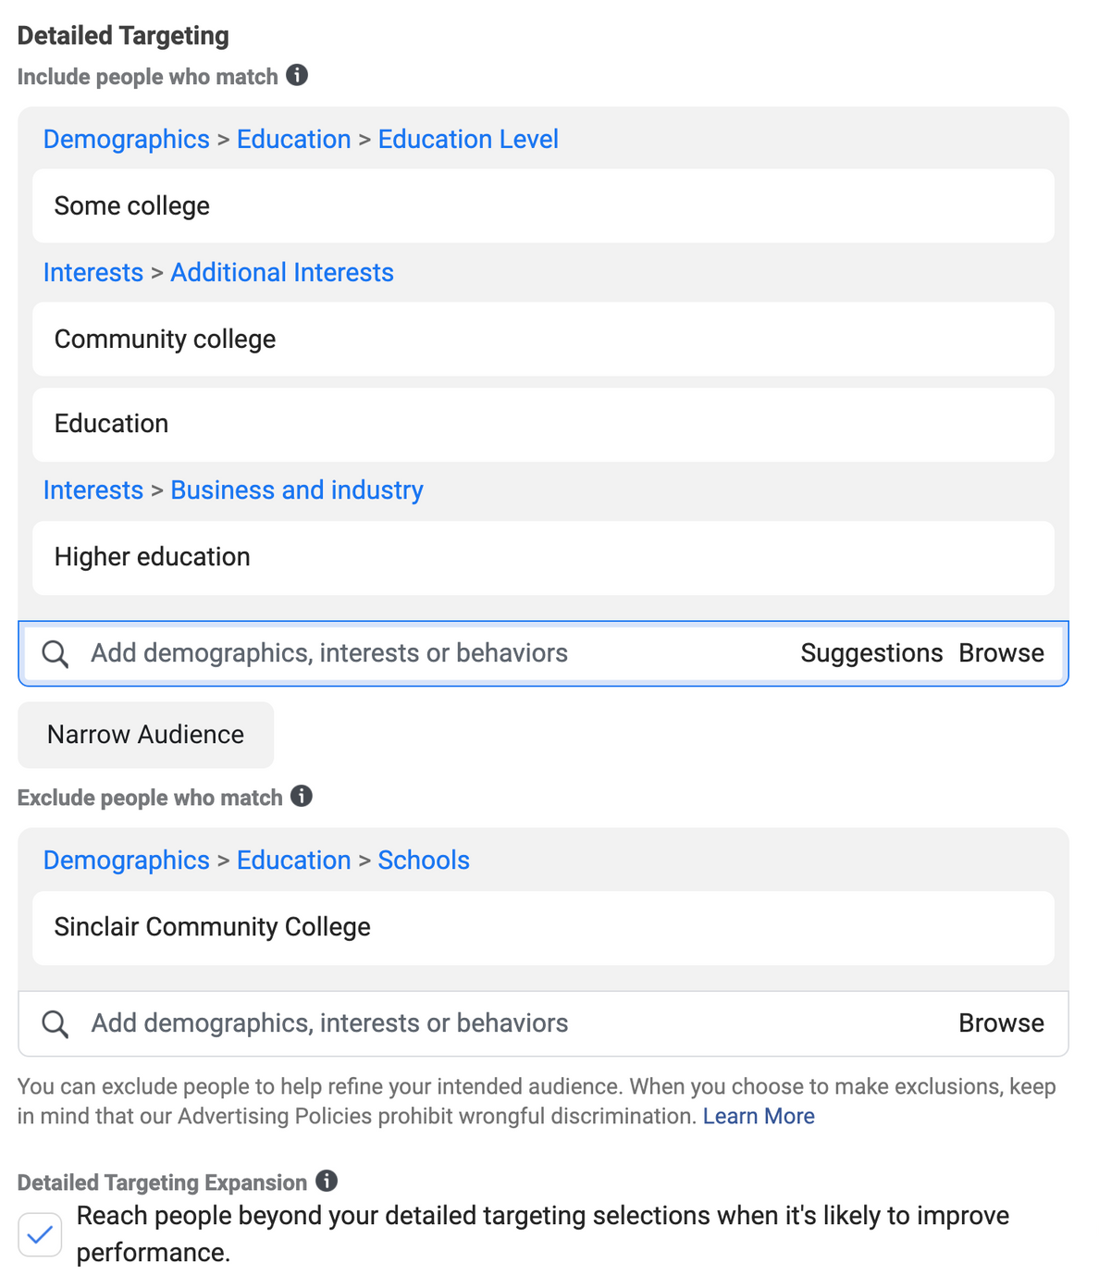
Audience
Ages:
18-50
Interests
Some college (returning students), community college, education, higher education
Exclusions:
Those who have Sinclair Community College listed in their education, those who work for Sinclair
Location:
People living in Ohio - possible to refine further?
Retargeting:
Use list from last campaign to create a custom audience using names, emails to retarget those interested in Respiratory Care program

Slide 18
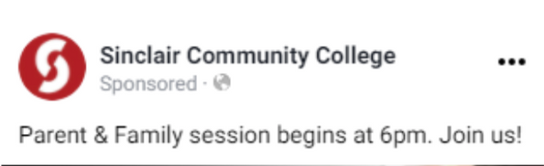
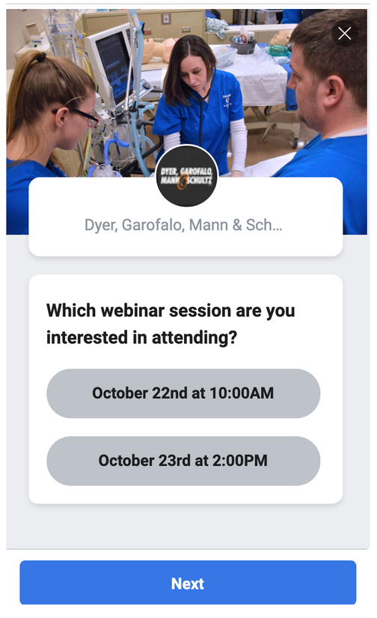
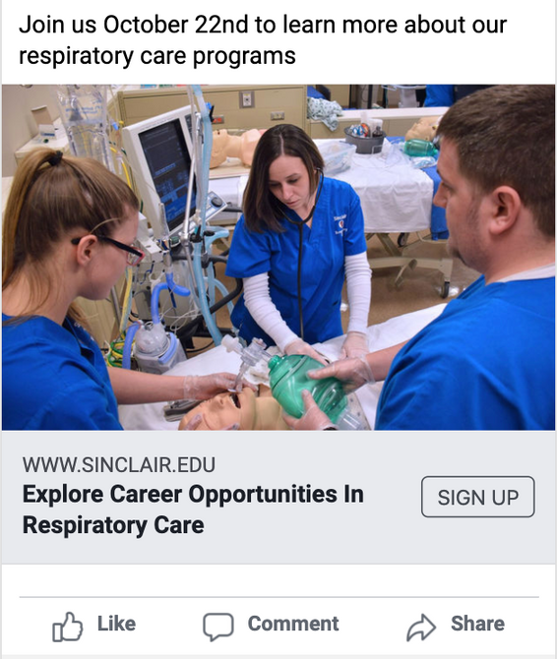

Social Ad Example
Facebook Ad Example
Facebook Instant Form Example
Headline (Focused on Respiratory Care Aspect)
- Explore Career Options In Respiratory Care
- Explore Career Opportunities in Respiratory Care
- Career Opportunities In Respiratory Care
Primary Text (Short details about the event)
- Join us Oct 22/23 to learn more about our respiratory care programs
Description (feel good snippet)
- Find your calling at Sinclair
CTA (What we want them to do -> Sign Up aka RSVP)
- Sign Up (either directly on Facebook/IG with Instant Form or by clicking through to landing page with form)

Slide 19

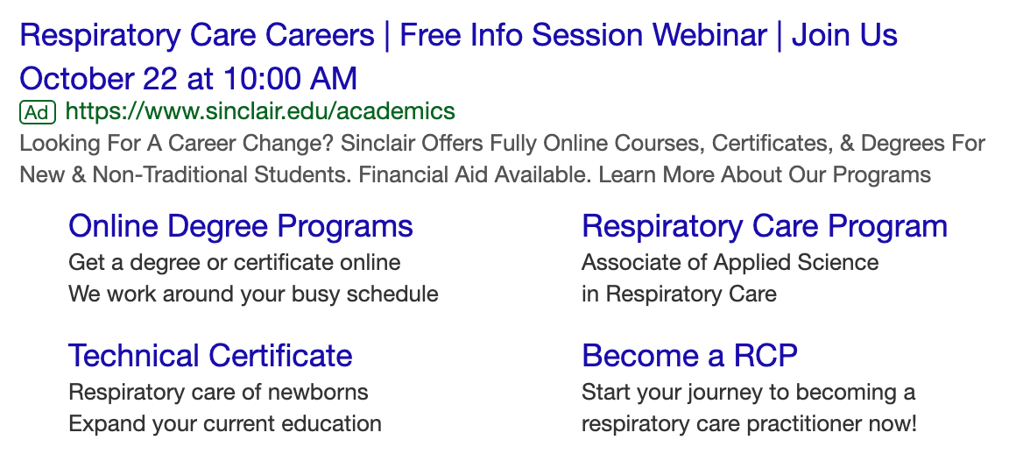
Google Ads Examples

